Slide 1
TOP-DOWN APPROACH
Journey to Your Best Program
Huynh Anh Tu

Slide 2

01. What is top-down approach ? 02. Why should we use this mentod? 03. When should we use it? 04. Where can we use it? 05. How to apply it on my assignment on the program?
WHAT IS TOP-DOWN APPROACH ?
AND
HOW TO APPLY IT ON YOUR ASSIGNMENT ON THE PROGRAM ?

Slide 3
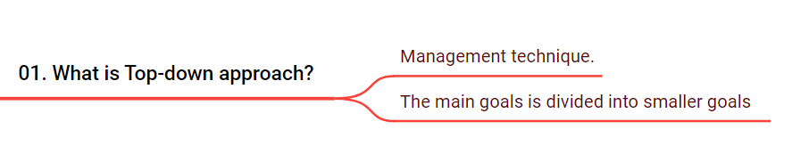
“Top-down approach” is a management technique.
Starts with a goal, and then identifies the key issues from that goal.
The big goal is divided into medium goals, and the medium goals are further divided into many small goals.
Big goal
Medium goals
Medium goals
Small goals
Small goals
Small goals
Small goals

Slide 4
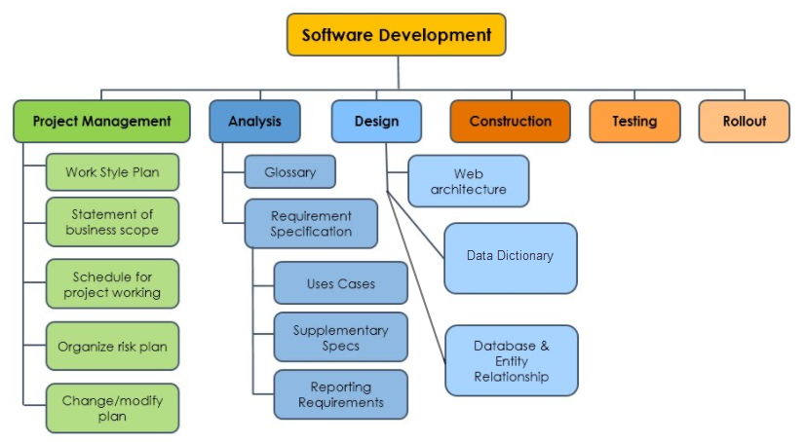
EXAMPLE

Slide 5

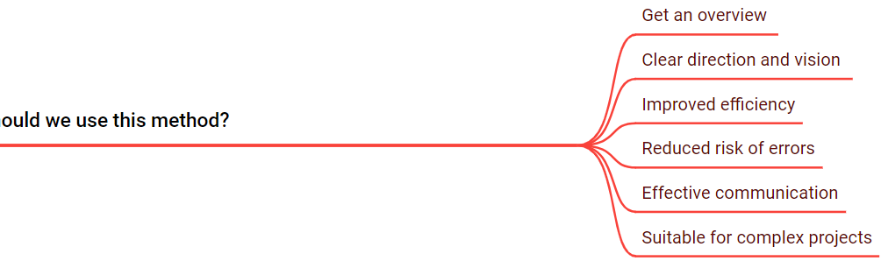
02. Why should we use this method?
Get an overview of the problem.
Clear direction and vision: Have a clear direction for you or for members to work together.
Improved efficiency: Break a complex problem into smaller tasks.
Reduced risk of errors: Identifies potential obstacles early on.
Effective communication: Clear hierarchy of goals and tasks.
Suitable for complex problems: Build a system with a clear division of tasks.

Slide 6
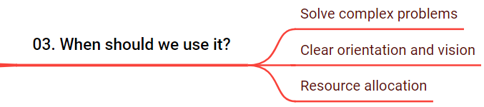

Solve complex problems:
Big problems require a high level of understanding
Large projects require strict requirements
Issues that require consistency
Clear orientation and vision:
Anticipating the consequences
Implementation of reforms
Announcing a new product
Resource allocation:
Manage large teams
Division of work
Issuance of general policy

Slide 7
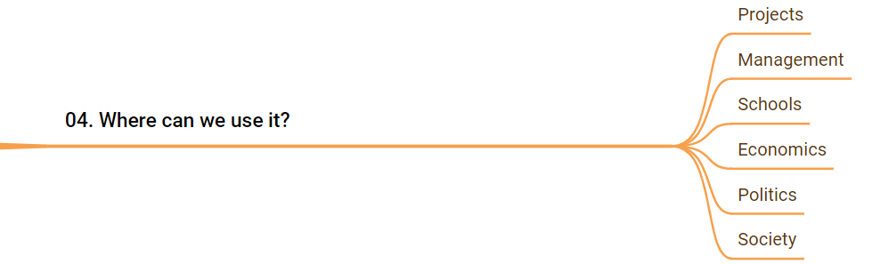

04. Where can we use it?
Projects: Project division
Management: Division of work
Schools: Lesson division
Economics: Market analysis
Politics: Policy enactment
Society: Division of management areas

Slide 8
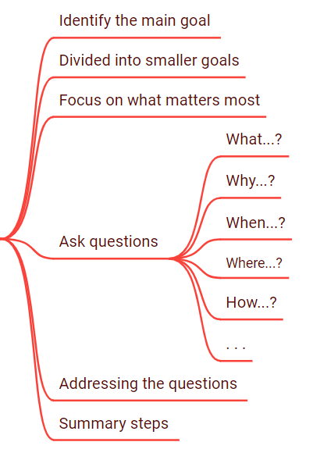
05. How to apply it on my assignment on the program?
Identify the main goal of the assignment.
Divide it into medium goals and small goals.
Focus on what matters most
Ask questions (What...?, Why...?, When…?, Where…? and How...?).
Addressing the questions posed.
Summary steps to complete the assignment.

Slide 9
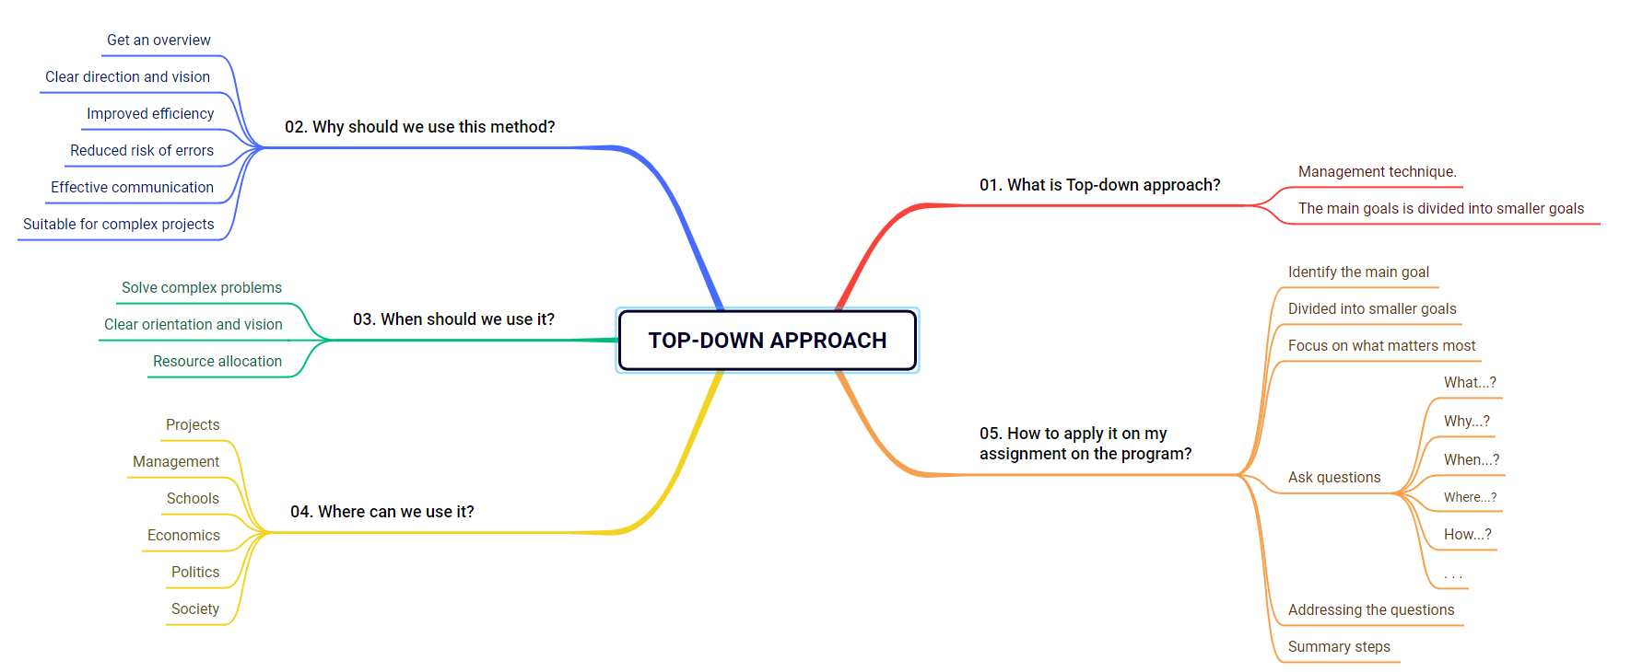
SUMMARY

Slide 10
THANKS!
Have a nice day!
Huynh Anh Tu
Phone: +84 929455098
Email: anhtu18042004@gmail.com

